Slide 1
Attacking and Defending
Cybersecurity 101 Day 2

Slide 2
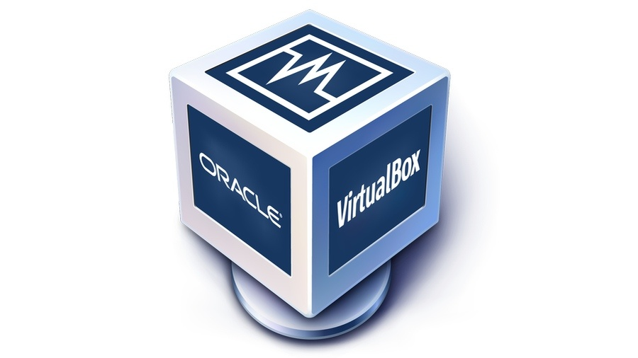
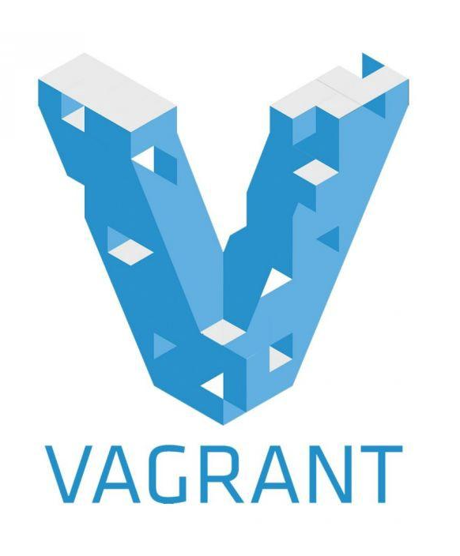
Today’s Class: VM Setup
In the second half of class, students will set up VirtualBox and Vagrant, two programs needed to run VMs on local machines.
You should have a basic familiarity with the need for VMs from our technical overview in the first day of class.
Today, we will dive into more detailed instructions of installation.
+
2

Slide 3

A Note on Troubleshooting
As we set up our virtual machines, we may have issues that require troubleshooting.
Troubleshooting is the process of problem solving.
In this course, troubleshooting will often involve ensuring that our virtual machines and lab services are running smoothly.
3
Notes:
shutterstock_1706055241

Slide 4

A Note on Troubleshooting
Whether you are a penetration tester, system administrator, SOC analyst, network admin, or IT help desk, you will most likely have to troubleshoot technology on a regular basis.
Troubleshooting will be a common theme throughout this course, and we'll be doing it alongside various activities, such as tinkering with scripts, configuring Azure Lab setups, and navigating access controls.
Just as troubleshooting is necessary in the professional environment, it will be necessary in this learning environment.
4
Notes:
shutterstock_1119950351

Slide 5
The Rising Cyber Threat
5

Slide 6

Why is cybersecurity such a desired skill these days?
Notes:
Image Source: AdobeStock_125741492

Slide 7

Reason 1: Explosive Growth in Dependence of IT
Nearly every personal, social, and commercial aspect of our lives makes contact with vulnerable IT infrastructure.
Notes:
Image sources: Shutterstock_1187923168 (couple at table); shutterstock_415082218 (online shopping); shutterstock_1177745851 (online prescription); shutterstock_1094829206 (online voting)

Slide 8

Reason 2: More Users (Targets) on Connected Devices
More people than ever before are logged into connected devices— often for the majority of their waking (and sleeping) hours.
Notes:
Image source: shutterstock_1075031486

Slide 9
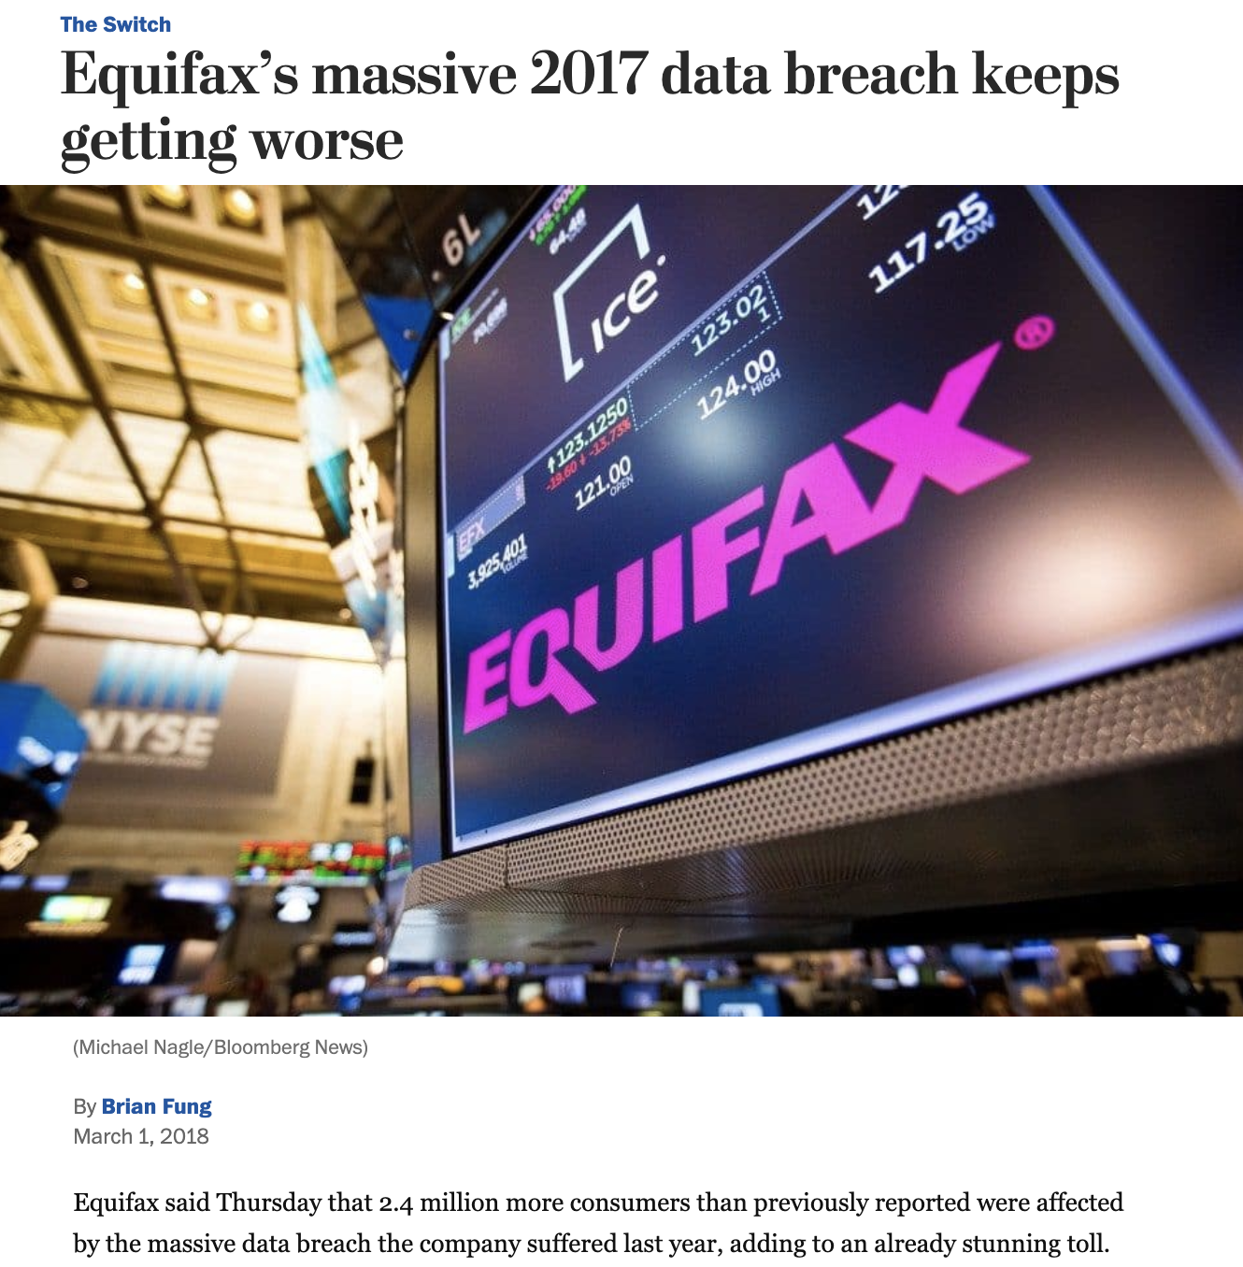
Reason 3: Better Tools for Bigger Damage
Today’s cyberattacks are becoming more sophisticated, aggressive, and disruptive than ever before.
Notes:
Low-Risk Image: Source https://www.washingtonpost.com/news/the-switch/wp/2018/03/01/equifax-keeps-finding-millions-more-people-who-were-affected-by-its-massive-data-breach/?noredirect=on&utm_term=.f63014925b4a

Slide 10
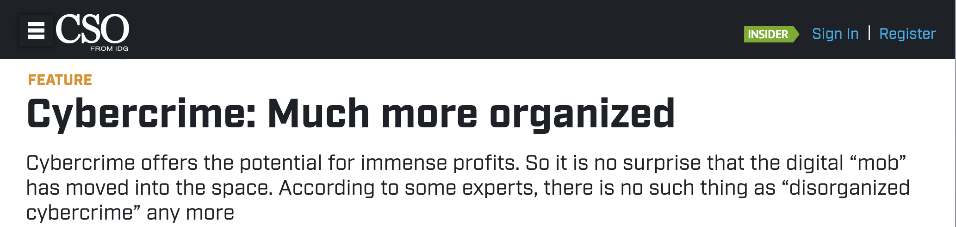
Reason 4: Significant Investment by Bad Actors
The field was once populated by individual “lone hackers.” It has now become a focal point for organized crime, nation states, and private enterprises.
Notes:
Headline source: https://www.csoonline.com/article/2938529/cybercrime-much-more-organized.html

Slide 11

Reason 5: Dire Shortage of Skilled Professionals
According to studies by (ISC)², there will be over 1.5 million unfilled cybersecurity positions by 2020.
“70% of cyber security professionals say that their organization has been impacted by the ongoing global cybersecurity skills shortage.”
Notes:
Quote Source: ESG Research Report, The Life and Times of Cybersecurity Professionals, November 2017
Image source: shutterstock_741657592

Slide 12
Defining Cybersecurity

Slide 13
What is the first thing you think of when you hear “cybersecurity”?
Notes:
Image Source: AdobeStock_125741492

Slide 14

Everyone’s First Thoughts:
Hackers and complicated code...
Notes:
Image sources: shutterstock_581898457 (hoodie person in background); shutterstock_635676176 (HACKER word and code overlay)

Slide 15
But cybersecurity isn’t about
hackers and complicated code...

Slide 16

Cybersecurity is really about assessing threats and mitigating risks.
Notes:
Image source: Mike Mirandi

Slide 17

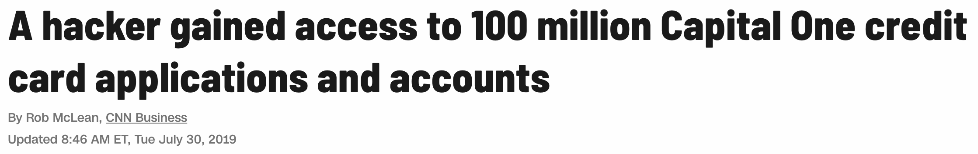
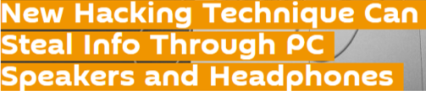
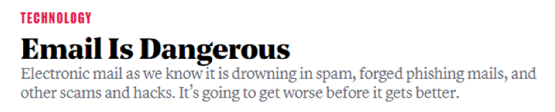
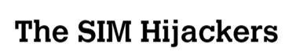
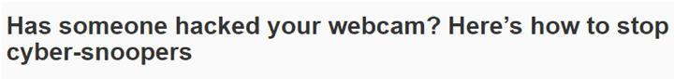

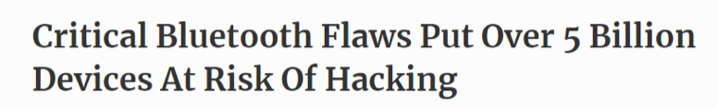
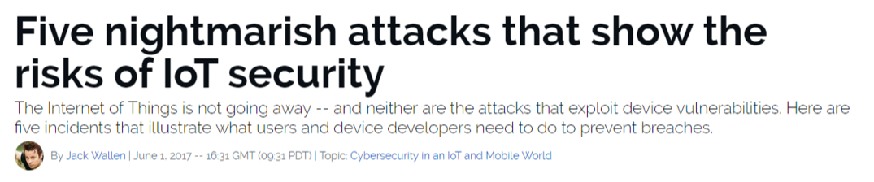
Know the Threats
To the experienced cybersecurity professional, risks are everywhere.
Notes:
Image source: shutterstock_1007525926

Slide 18

Mitigating Risks
Historically, organizations viewed cybersecurity from the lens of the castle model: Managing risks meant building walls and keeping the bad actors out.
Today, security professionals operate in a world where breaches are assumed, and risks associated with such events also need to be mitigated.
Notes:
Image sources: shutterstock_600449171 (castle); shutterstock_1014968650 (horse)

Slide 19
Security Challenge #1: Attacking the Wall
19

Slide 20

We will now work on two security challenges related to assessing threats and mitigating risks.
20

Slide 21

SECURITY CHALLENGE #1
Attacking the Wall
In this first activity, we will look at various attack strategies that hackers can use to penetrate an insecure login.
While you will be new to this type of thinking, this exercise should force you to think creatively about all the ways a system can be penetrated, from user attacks to physical break ins.
To successfully complete this exercise, you must think through creative options.
Let’s take a look at the scenario...
21
Notes:
shutterstock_1095422036

Slide 22

SECURITY CHALLENGE #1
Secure our code? Nah...
We met on BondingThroughBitcoin.com!
Congratulations! You and your team have just been hired by a very successful startup that runs a bitcoin dating exchange.
While their founding team is brilliant, like many startups, they don’t know the first thing about security.
Notes:
Image sources: shutterstock_1485124850 and shutterstock_1138455068

Slide 23
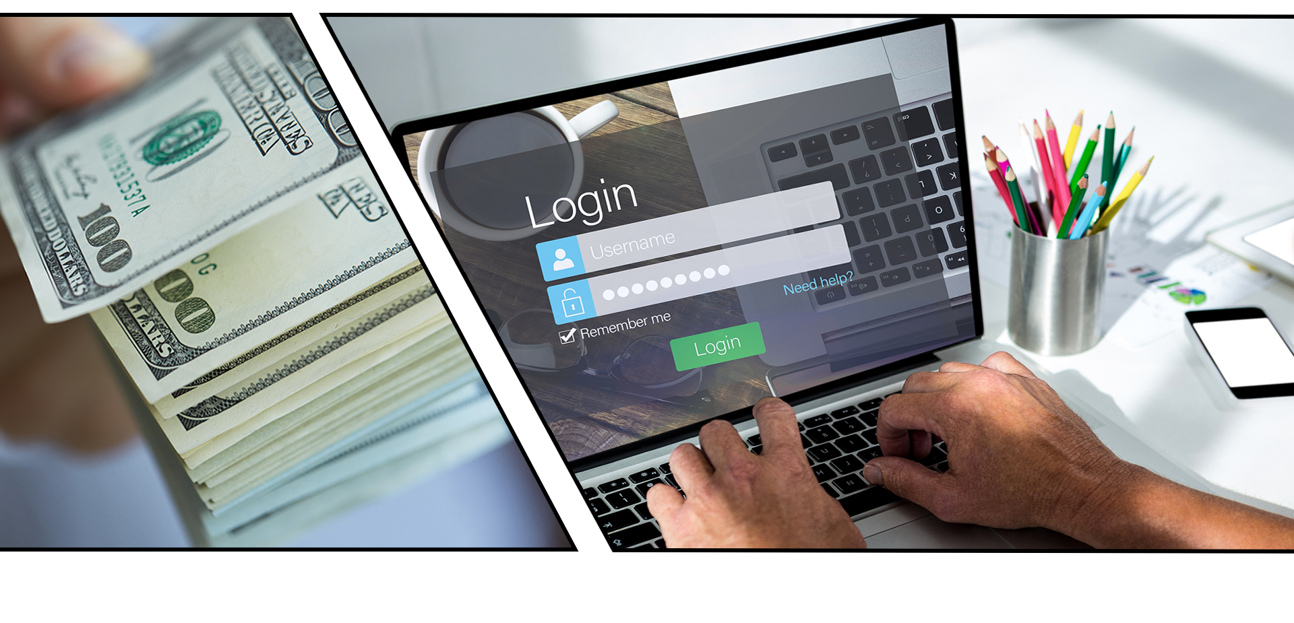
SECURITY CHALLENGE #1
They just handed you a ton of cash to solve their most critical problem.
Their login process is totally insecure. Hackers are routinely logging in as users (and administrators) and gaining access to company data and financial assets.
23
Notes:
Image sources: shutterstock_237968428 and shutterstock_641686837

Slide 24
Activity: Security Challenge #1:
Attacking the Wall
In this security challenge, you and your group will play the role of security professionals tasked with handling a real-world situation.
20 Minutes

Slide 25
25

Slide 26


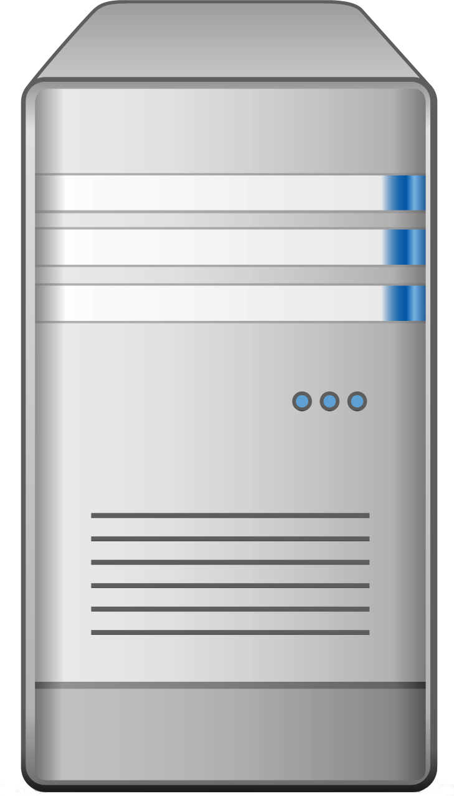

Activity: Security Challenge #1: Attacking the Wall
Web Logins 101
Login
Web Login
Server
Data
We’ll spend a lot more time talking about web logins later in this course, but for now we’ll use this diagram as a guide.
Users and Admins

Slide 27
Activity: Security Challenge #1: Attacking the Wall
Web Logins 101
Login
Web Login
Server
Data
Defend this at all costs!
Users and Admins

Slide 28
Step #1:
Assess the Target

Slide 29
Activity: Security Challenge #1: Attacking the Wall
A Lot of Targets
Login
Web Login
Server
Data
In this case, an attacker can target
every node along the chain.
Users and Admins

Slide 30
Activity: Security Challenge #1: Attacking the Wall
User Attacks
Login
Web Login
Server
Data
Users are subject to a variety of social engineering tactics.
Users and Admins

Slide 31
Activity: Security Challenge #1: Attacking the Wall
Web Attacks
Login
Web Login
Server
Data
Websites are vulnerable to a broad range of code-related attacks.
Users and Admins

Slide 32
Activity: Security Challenge #1: Attacking the Wall
Server Attacks
Login
Web Login
Server
Data
Servers are vulnerable to many operating system exploits and attacks.
Users and Admins

Slide 33
Activity: Security Challenge #1: Attacking the Wall
Data Center Attacks
Login
Web Login
Server
Data
Data centers are vulnerable to physical and cloud attacks.
Users and Admins

Slide 34
Step #2:
Define Attack Strategy

Slide 35
Activity: Security Challenge #1: Attacking the Wall
First up: User Attacks
Login
Web Login
Server
Data
Users and Admins

Slide 36

Step 2: Defining Attack Strategies
Attack Option #1: Social Engineering
A hacker can ask users for their credentials by pretending to be an administrator.
Fake admin

Slide 37
Step 2: Defining Attack Strategies
Attack Option #2: Phishing
A hacker can attempt a phishing attack, where users are redirected to fake login pages that capture user credentials.
Fake login
Login
Login

Slide 38
Step 2: Defining Attack Strategies
Attack Option #3: Credential Reuse
A hacker can find users’ login and password information on other websites.
Recycled password
Login
Login
Login

Slide 39

Step 2: Defining Attack Strategies
Attack Option #4: Malware
A hacker can deploy malware such as spyware or keyloggers to capture daily user activity.
Login
Malware

Slide 40
Step 2: Defining Attack Strategies
Attack Option #5: Man in the Middle Attack
A hacker can create a man in the middle attack by providing a free WiFi hotspot to capture user credentials.
WiFi
Login
Shady WiFi

Slide 41
Step 2: Defining Attack Strategies
Attack Option #6: Sniff Packet
A hacker can sniff packet traffic across insecure wireless
networks such as a cafe or restaurant.
Packet Sniff
WiFi
Login

Slide 42
Step 2: Defining Attack Strategies
Attack Option #7: Stolen Hardware
A hacker can simply steal a computer and use the saved credentials to login.
Login
Stolen laptop

Slide 43
Activity: Security Challenge #1: Attacking the Wall
Next: Web Attacks
Login
Web Login
Server
Data
Users and Admins

Slide 44
Step 2: Defining Attack Strategies
Attack Option #8: Brute Force Attack
A hacker can use a brute force attack to continuously attempt username and password combinations.
Username: bob@bbb.com Password: Love
Username: bob@bbb.com Password: Love123
Username: bob@bbb.com Password: Love123!
Username: bob@bbb.com Password: L@ve123
Login
Password dictionary

Slide 45
Step 2: Defining Attack Strategies
Attack Option #9: Code Injection
A hacker can use a code-injection attack to inject malicious code directly into username or password fields.
Username:
uName = getRequestString("username");
uPass = getRequestString("userpassword");
sql = 'SELECT * FROM Users WHERE Name ="' + uName + '" AND Pass ="' + uPass + '"'
Login
Password dictionary

Slide 46
Step 2: Defining Attack Strategies
Attack Option #10: Faulty Session Management
A hacker can exploit faulty session management, when developers incorrectly implement code used to maintain login and logouts.
{}
SessionID Swap
Login
{}

Slide 47
Activity: Security Challenge #1: Attacking the Wall
Next Up: Server Attacks
Login
Web Login
Server
Data
Users and Admins

Slide 48
Step 2: Defining Attack Strategies
Attack Option #11: OS Exploits
Servers, which run on operating systems like Windows and Linux, are subject to OS exploits when incorrectly patched.
Vulnerable OS

Slide 49
Step 2: Defining Attack Strategies
Attack Option #12: Malicious Software
Malicious software can be directly loaded onto the server by USB or other means.
Vulnerable OS

Slide 50
Activity: Security Challenge #1: Attacking the Wall
Next Up: Server Attacks
Login
Web Login
Server
Data
Data centers are vulnerable to physical and cloud attacks.
Users and Admins

Slide 51
Step 2: Defining Attack Strategies
Attack Option #13: Default Credentials
Database management systems often come with default credentials, which might be left unchanged.
Username: postgres
Password= “”
Default Credentials

Slide 52
Step 2: Defining Attack Strategies
Attack Option #14: Unpatched Database
Database management systems might be unpatched against publicly known vulnerabilities.
Unpatched DBMS

Slide 53
Step 2: Defining Attack Strategies
Attack Option #15: Lack of Segregation
The database might allow a client to look at another client’s data.
Lack of Segregation

Slide 54
Security Challenge #2

Slide 55

SECURITY CHALLENGE #2
Defending the Wall
In the same groups, you will now use your list of potential attacks from the previous activity to develop a list of at least 10 strategies to mitigate the website’s risk.
As you work through this scenario, consider the following:
Can any mitigation strategies be used to handle multiple threats at once?
55
Notes:
shutterstock_1095422036

Slide 56
Activity: Security Challenge #2:
Defending the Wall
Now that we’ve assembled a list of potential attacks, your next task is to develop a list of at least 10 strategies to mitigate the website’s risk of unauthorized access. Be prepared to share!
20 Minutes

Slide 57
57

Slide 58
Activity: Security Challenge #2: Defending the Wall
User Attacks
Web Attacks
Database Attacks
Social engineering
Brute force attacks
Default credentials
Phishing attacks
Code injection
Unpatched database
Credential reuse
Faulty sessions
Lack of segregation
Malware attacks
Man in the middle
Server Attacks
To get started, review this list of identified attack types.
Packet sniffing
OS exploits
Computer theft
Malicious software

Slide 59
Step Three:
Risk Mitigation Plan

Slide 60
Step 3: Risk Mitigation Plan
User Attacks
Web Attacks
Database Attacks
Social engineering
Brute force attacks
Default credentials
Phishing attacks
Code injection
Unpatched database
Credential reuse
Faulty sessions
Lack of segregation
Malware attacks
Man in the middle
Server Attacks
Risk mitigation begins by assessing all risks and looking for parallels.
Packet sniffing
OS exploits
Computer theft
Malicious software

Slide 61
Step 3: Risk Mitigation Plan
User Attacks
User Risk Mitigation
Educate all users on the danger of phishing and social engineering.
Use randomly generated passwords.
Ensure users are using multi-factor authentication (password + phone confirmation).
Use HTTPS and only access sensitive content over secure channels.
Social engineering
Phishing attacks
Credential reuse
Malware attacks
Man in the middle
Packet sniffing
Computer theft

Slide 62
Step 3: Risk Mitigation Plan
Web Attacks
Web and Server Risk Mitigation
Ensure strong passwords are used (alphanumeric + symbol + special characters).
Sanitize any input in the web application form fields and filter the output.
Ensure users are immediately logged out when closing a browser. (Logins are erased after 30 seconds of inactivity.)
Ensure all servers are routinely patched against latest known vulnerabilities.
Incorporate antivirus and user education.
Brute force attacks
Code injection
Faulty sessions
Server Attacks
OS exploits
Malicious software

Slide 63
Step 3: Risk Mitigation Plan
Suggested Plan
Educate all users on the dangers of phishing and social engineering.
Require randomly generated passwords.
Ensure users have multi-factor authentication (password + phone confirmation).
Use HTTPS and only access sensitive content over secure channels.
Ensure strong passwords are used (alphanumeric + symbols).
Sanitize any input in the web application form fields and filter the output.
Ensure users are immediately logged off when closing a browser.
Ensure all servers are routinely patched against latest known vulnerabilities.
Ensure physical access to servers is protected by multiple forms of authentication (login + biometric).
Ensure all data stored in the database is encrypted and cannot be read without additional login information.
Provide database access on need-to-know basis.
Log and monitor all database access.
Ensure all cloud security platforms follow best practices for security implementation.
Notes:
As security professionals, we will make our recommendations based on observed risks. In conjunction with our clients, we will also make decisions on the best course of action.

Slide 64

64
Notes:
Image source: AdobeStock_56885471

Slide 65
For the rest of today’s class, we will be setting up the virtual environments that we’ll use for the majority of technical activities in the course.
65

Slide 66
The CIA Triad

Slide 67

Now, we will move on to our first concept: the three cornerstones of information security, known as the CIA triad.
1
Confidentiality
2
Integrity
INFORMATION
SECURITY
3
Availability
Notes:
Image source: shutterstock_708213337 (shield)

Slide 68
What do each of these words mean to you?
Confidentiality
Integrity
Availability
Notes:
Image Source: AdobeStock_125741492

Slide 69

Confidentiality
The state of being kept secret or private.
This corner of the CIA triad is all about ensuring sensitive information does not reach unauthorized people.
Examples of confidentiality attacks include uploading private photos and communications onto a forum and exposing credit card numbers online.
Confidentiality comes down to the principle of “need to know.” Data or information should only be made available to those who need access to it.
Confidentiality is enforced through measures like encryption and authentication.
1
Confidentiality

Slide 70
Integrity
The quality of being honest, whole, or undivided.
The integrity of information refers to protecting information from being modified by unauthorized parties.
Examples of integrity attacks include intercepting money transfers and changing the dollar amount in seemingly insignificant ways, so the excess can be sent elsewhere, and altering university grades to be better or worse.
Integrity attacks can be avoided by using
a secure hashing algorithm and process
when transferring data to ensure it
isn’t tampered with in transit.
2
Integrity

Slide 71
Availability
The quality of being able to be used or obtained.
Availability concerns occur when operating systems, equipment, and data are not functioning correctly, limiting accessibility to those who need it.
Examples of availability attacks include hackers taking down a web-connected generator and disabling a critical power supply, and using a denial of service attack to bring down a financial service provider’s website, making it impossible for clients to make transactions.
Creating regular backups of data is one way to maintain availability.
3
Availability

Slide 72
We will revisit these terms regularly throughout the course, and explain how various topics, skills, and practices are concerned with protecting each.
1
Confidentiality
2
Integrity
INFORMATION
SECURITY
3
Availability
Notes:
Image source: shutterstock_708213337 (shield)

Slide 73
Introduction to Virtual Machines
73

Slide 74




Physical Machines
To most people, a computer means a physical laptop or desktop computer made of hardware, such as:
Monitors
Graphic Cards
Hard Drives
etc.
Notes:
AdobeStock_134236397_monitor AdobeStock_134236397_graphic card AdobeStock_134236397_hard drive

Slide 75
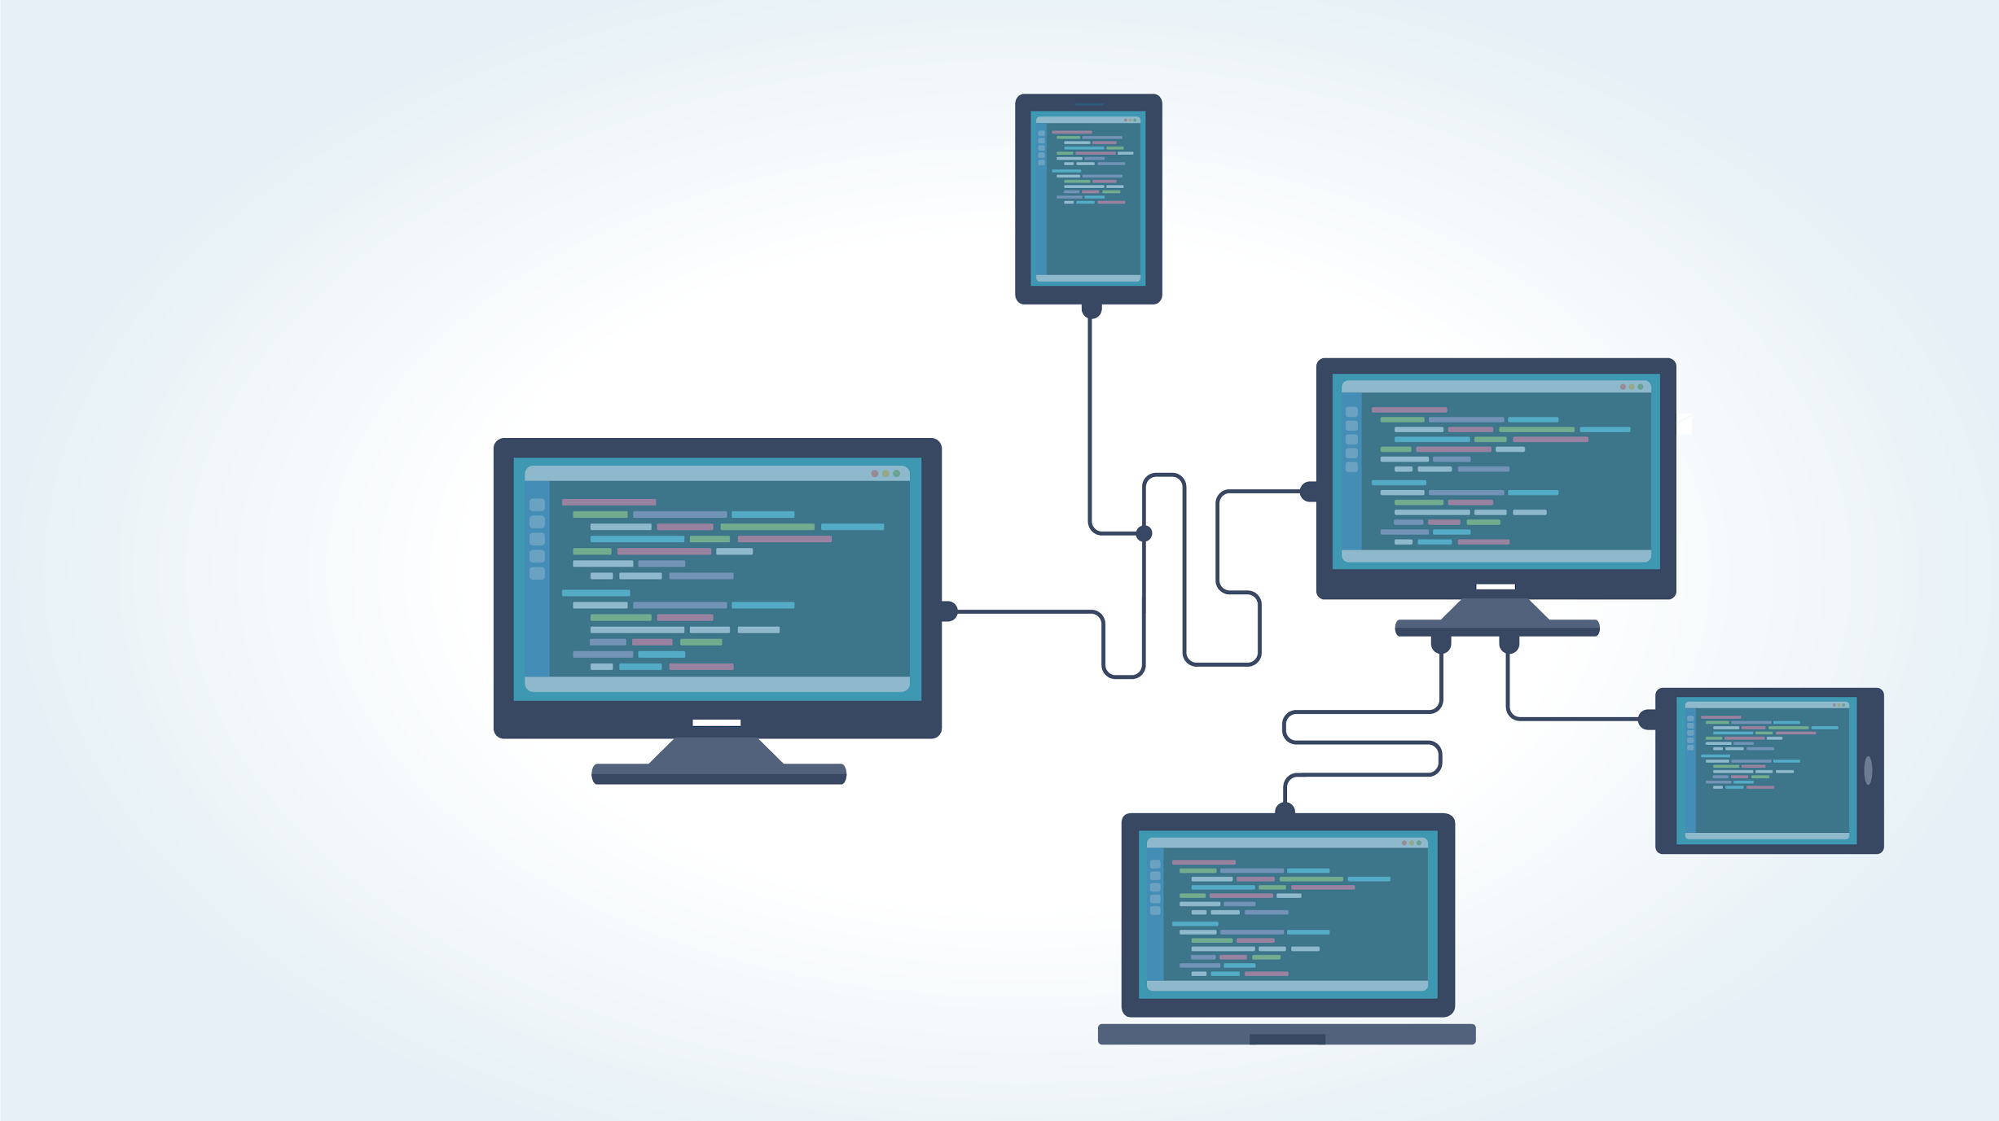
Virtual Machines
It is possible to write programs that simulate entire physical computers.
Notes:
AdobeStock_118280676

Slide 76

Virtual Machines
Virtual machines are programs that simulate entire computers.
Virtual machines (VMs) can operate as entirely different computers than the one they’re running on.
We can run many different VMs on a single physical computer.
Notes:
AdobeStock_156132408_Extended

Slide 77

Physical vs. Virtual Machines
Virtual
vs.
Physical
Easy and inexpensive (or free) to set up.
Easily distributed. In this class, we’ll be distributing VMs so each student is running the exact same setup.
Multiple VMs can be placed on a single physical machine.
Typically more efficient because they have direct access to hardware components.
77
Notes:
AdobeStock_243233772

Slide 78
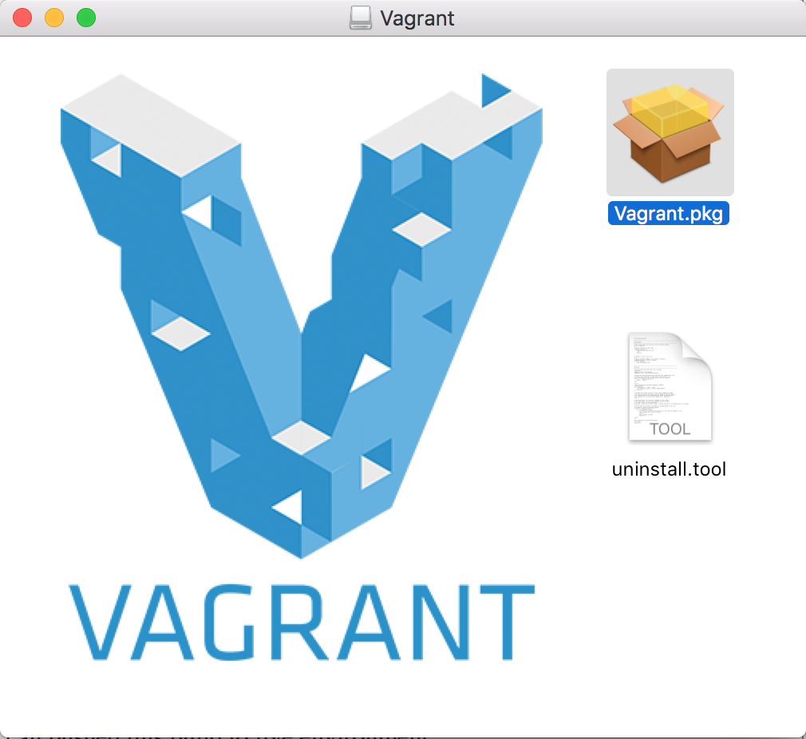
Setting Up Our Virtual Machines
Let’s get started setting up our virtual environments. For the rest of the class, we’ll focus on the three-step installation process outlined in the Using Vagrant document:
01
Accessing the command line and downloading VirtualBox and Vagrant.
02
Downloading the virtual machine using Vagrant files and scripts.
03
Accessing the virtual machine.
78

Slide 79
Everyone Do: Local Machine Setup
As a class, we will set up our virtual machines. Make sure you have access to the Using Vagrant documentation.
79

Slide 80

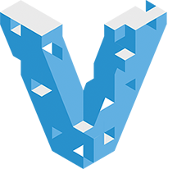
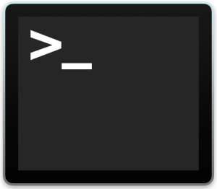
Accessing the command line and downloading VirtualBox and Vagrant.
Step 1
To run virtual machines, we will first need to make sure that we have the following tools installed:
Git Bash for Windows users
VirtualBox A virtualization tool we will use to run various lab activities. VirtualBox allows us to run different operating systems on our local machines.
Vagrant A tool we'll use to build and set up these virtual environments. Vagrant will allow us to run scripts that install these virtual machines, which will then be run using VirtualBox. We will run these scripts using Git Bash or Terminal.
Terminal for Mac users
80

Slide 81
Does everyone have Git Bash or Terminal, VirtualBox, and Vagrant installed?
If so, let’s move on.
Notes:
Image Source: AdobeStock_125741492

Slide 82
Downloading the virtual machine using Vagrant files and scripts.
Step 2
Now that we have our tools installed, we need to download the following files:
vagrant-linux.sh
A script file that ensures your virtual machine is installed properly on your computer.
Vagrantfile
A file that configures and defines your virtual machine setup. In our case, this Vagrantfile, when executed via the vagrant-linux.sh script, configures the custom Linux Ubuntu machine you are using.
Once you have these files on your machine, work through Part 2 of the Using Vagrant documentation.
82

Slide 83
Has everyone set up their virtual machine using vagrant.linux.sh and Vagrantfile?
If so, let’s move on.
Notes:
Image Source: AdobeStock_125741492

Slide 84
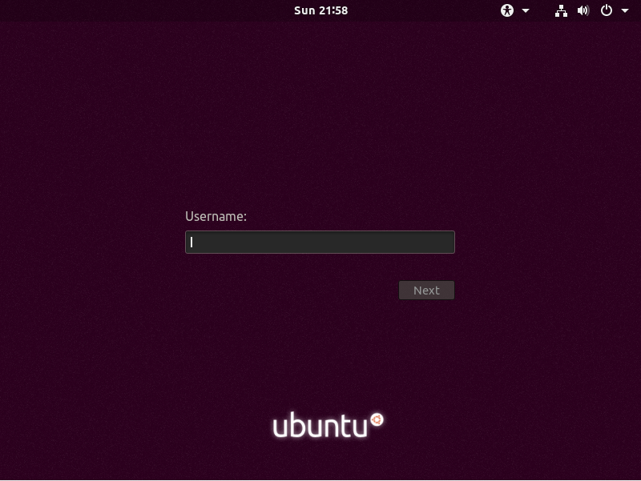
Accessing the virtual machine.
Step 3
Now we will access the graphical user interface (GUI) of our virtual machine.
Use Part 3 of the Using Vagrant documentation to access your virtual machine.
84

Slide 85
VM Setup Confirmation
At this point, everyone should have:
01
02
03
Accessed the command line and downloaded VirtualBox and Vagrant.
Downloaded the virtual machine using Vagrant files and scripts.
Accessed the virtual machine.
85

Slide 86
VM Maintenance (If time allows)
86

Slide 87

VM Maintenance
After Step 3 in the Using Vagrant documentation are instructions and guidelines for advanced virtual machine setup and maintenance.
You are encouraged to read this material.
Once we begin using our virtual machines in Week 3, we will need to complete these instructions to make sure our VMs have the latest updates.
87
Notes:
shutterstock_1214117458

Slide 88
VM Maintenance
Specifically, we will run the following commands to get our VMs up to date:
vagrant box update, to get the most recently updated virtual machine. This might take several minutes or longer, depending on your internet connection.
vagrant destroy within the directories where your Vagrantfiles are installed, to ensure that the virtual machines are stopped and all associated files are removed.
vagrant up, to launch the newer version.
vagrant box prune (optional) afterwards, to delete all old, unused versions of the virtual machine.
88

Slide 89
Any Questions?

